Slide 1
Solar Sails for Remote Sensing, Space Weather, and Communications
Ben Diedrich
NOAA Satellite and Information Service
NOAA Technology Summit
November 3, 2010

Slide 2
Abstract
Solar sails are large, lightweight mirrors that push spacecraft by the gentle pressure of reflected sunlight. In the vicinity of Earth, the gentle, continuous, fuel-free thrust of solar sails enables whole new families of orbits with a new perspective on the Earth and sun-Earth connection. Solar sails may enable early detection of space weather events that disrupt power grids, communications, and navigation. They may also enable continuous monitoring of polar weather and climate parameters, and intercalibrate multiple observing systems in space and on Earth. NASA’s Galileo mission to Jupiter provided valuable remote sensing proxy data during an Earth flyby in 1990. The unique vantage point of solar sails may also enhance data transfer from polar satellites and polar ground stations. Solar sails are no longer science fiction; the Japan Aerospace Exploration Agency (JAXA) is flying the first solar sail spacecraft on a test flight to Venus. Several small Cubesat solar sail spacecraft are under development for flight over the next few years. Prior NASA research developed high performance sail technology on the ground.

Slide 3
Summary
Solar sails & solar sailing
Why NOAA?
Orbits
Space Weather
Weather and Climate
Communications
Challenges
Opportunities

Slide 4
Sailing
Equal & opposite
Force on the sail
“Stuff” with momentum
(e.g. air, sunlight)
Force on “stuff” from deflection by sail
Sail deflects
“stuff”

Slide 5
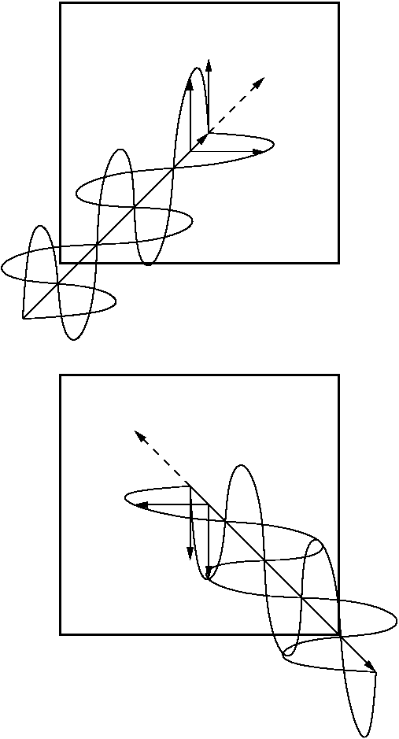
Solar Pressure
Sunlight
Electromagnetism
Electric field induces current, magnetic field induces force
Relativity
Photons have momentum: E=mc² -> p=E/c
Low pressure: ~9x10⁻⁶ N/m²
Solar wind
Charged particles
Thousands of times less pressure
Highly variable
j
E
jxB
B
Incident
jxB
B
j
E
Reflected

Slide 6
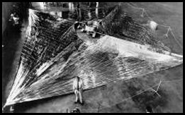
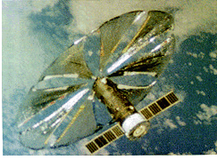
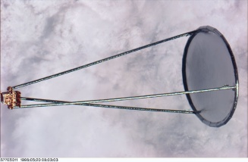
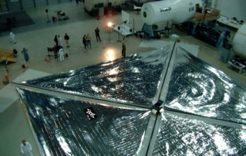
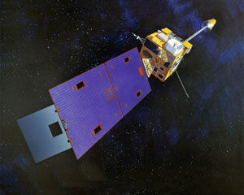
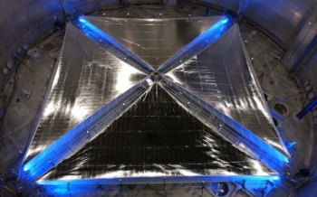
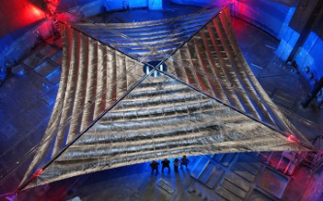
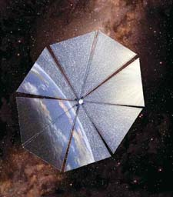
Solar Sails
All spacecraft perturbed by solar pressure, some employ it
Large, lightweight mirror maximizes acceleration from sunlight
Numerous ground developments, orbital & suborbital deployments
Japan Aerospace Exploration Agency (JAXA) flying the first solar sail to Venus
Interplanetary Kite-craft Accelerated by Radiation Of the Sun (IKAROS)
1981, WSF 15-m ground demo
1993, SRC Znamya-2
20-m orbital reflector
1996, NASA/JPL/L’Garde
14-m Inflatable
Antenna Experiment
1999, DLR 20-m ground demo
GOES I-M
solar sail & trim tab
2004, NASA/ATK
20-m prototype
2004, NASA/L’Garde
20-m prototype
2005, Cosmos 1 flight
launch vehicle failure
2010 JAXA IKAROS flight

Slide 7
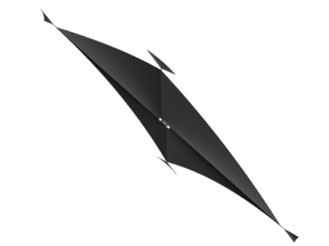
Solar Sailing
Steering the sail points force direction
Force from absorbed sunlight & reaction force from reflected sunlight
Total force perpendicular to sail
Pointing with orbit velocity grows orbit, sailing away from the sun
Pointing against velocity shrinks orbit to sail towards the sun
Total
force
Incident
Reflected

Slide 8
Why NOAA?
Space weather
Communications
Weather
Climate
Notes:
Earth & human civilization

Slide 9
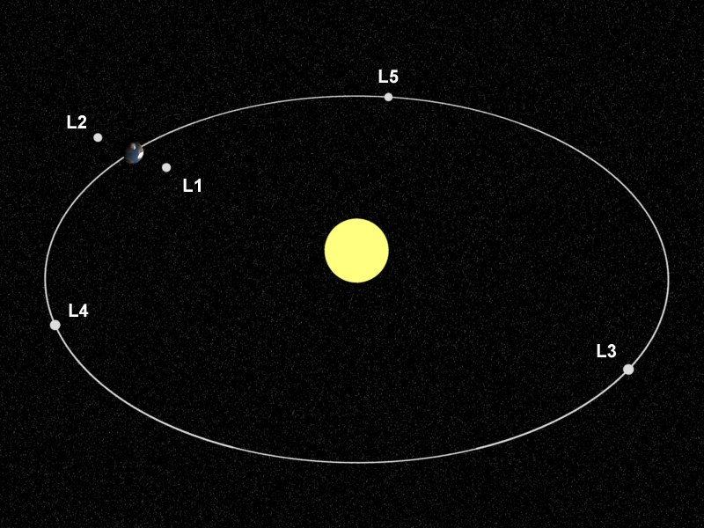
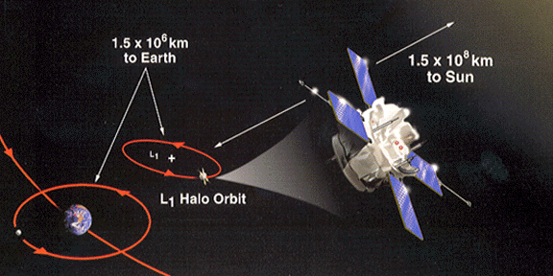
Lagrange Orbits
Orbits closer to the sun than Earth move faster; those farther move slower
At L1, Earth’s gravity subtracts from the sun’s gravity (at L2 it adds), changing the orbit speed to match Earth’s
NASA Advanced Composition Explorer (ACE) and Solar and Heliospheric Observatory (SOHO) orbit L1, 1.5Mkm sunward of Earth
ACE detects solar wind changes leading to geomagnetic storms at Earth 30-60 minutes later

Slide 10
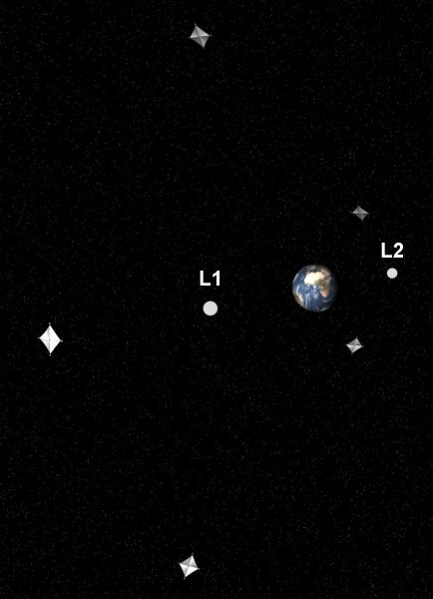
Artificial Lagrange Orbits (ALOs)
Continuous thrust subtracting from solar gravity (adding to Earth’s) can move a Lagrange orbit closer to the sun than L1
Thrust out of the orbit plane can lift a Lagrange orbit high enough to view Earth’s poles year round
Solar sails, ion engines, combination of the two
Solar sails maintain without propellant
1.5 Mkm
150 Mkm
to sun

Slide 11
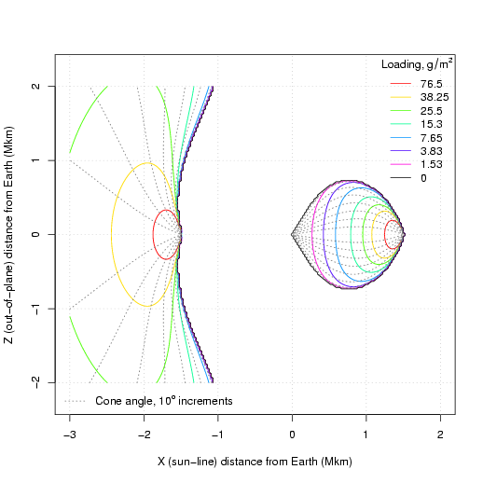
Sail Performance & ALOs
Sail of given performance (mass/area) has choice of orbit positions
L₁
Earth
L₂

Slide 12
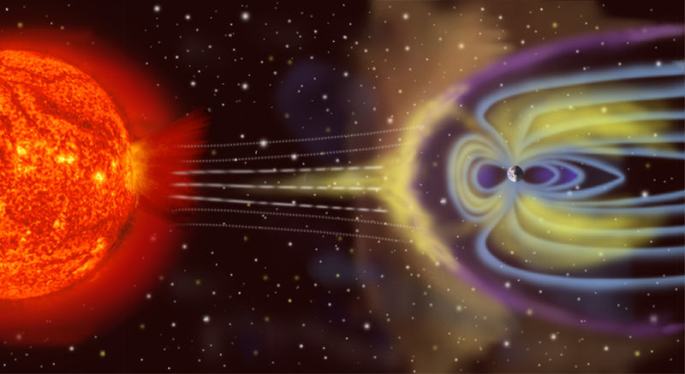
Solar Wind
Solar wind disturbances impact Earth’s magnetosphere causing geomagnetic storms
Damaging currents in power grids & oil pipelines
Ionosphere disruption degrading communications & navigation

Slide 13
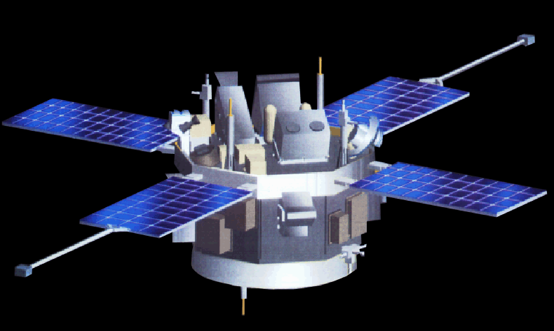
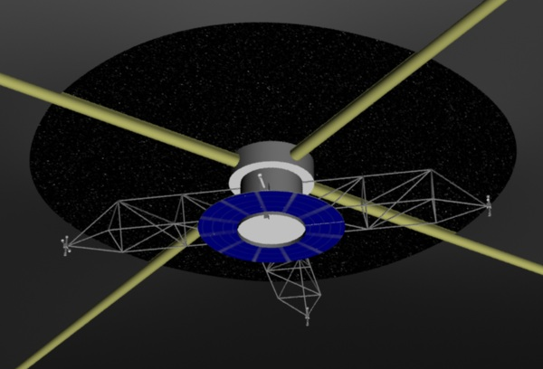
Solar Wind Observation
Present
NASA Advanced Composition Explorer in L1 orbit
Planned
Deep Space Climate Observatory (DSCOVR)
Future
Commercial service?
Sub-L1 solar sail
2X to 10X warning time?
Notes:
Bottom line: Solar sails increase warning time.
Prior NOAA/NASA/DoD project (NOAA funded) Geostorms: 2X warning time with near-term technology
SWPC director has expressed that 10X early warning – a stretch goal for near-term sail technology – would align with the desire for L5 observations of heliospheric coronal mass ejections and solar wind streams

Slide 14
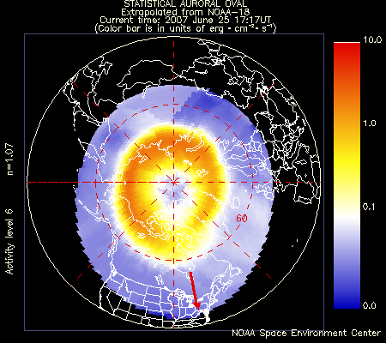
Aurora & Ionosphere
Auroral boundary, energy deposition, and imagery are used to identify impacts to radar operations and communications in polar latitudes.
Ionospheric scintillation affects HF communications at high latitudes

Slide 15
Auroral & Ionospheric Scintillation Observation
Present
Maps stitched together every few hours from particle detectors and imagers on polar environmental satellites
Future?
UV imagers in polar L2 ALOs would produce hemispheric auroral maps near realtime
Radio beacons in polar ALOs coupled to array of ground receivers for scintillation measurement, augmented by UV imaging
Notes:
Bottom line: Polar satellites provide geographic coverage but poor temporal coverage (hours between passes, stiched together into maps), but solar sails enable realtime, hemispheric view of the entire aurora from 2 satellites.

Slide 16
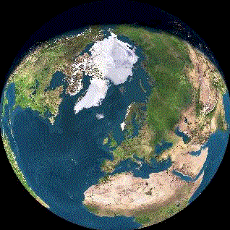
Weather and Climate
Realtime, continuous, hemispheric observation of the poles
Studies over several years identified several potential applications
Clouds
Aerosols
Vector winds
Earth radiation budget
Ozone
Carbon gases
Sea surface temperature
Intersatellite calibration
“Stitching” piecemeal high resolution LEO & GEO data
North Pole view in winter
North Pole view in summer

Slide 17
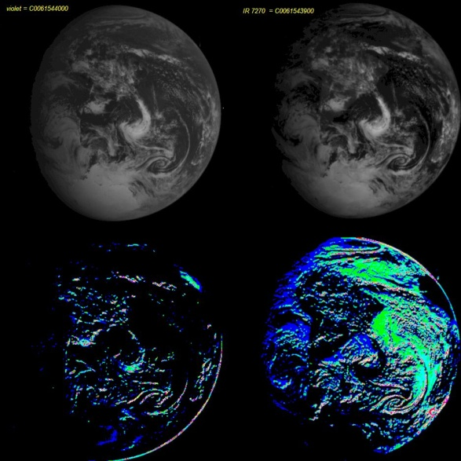
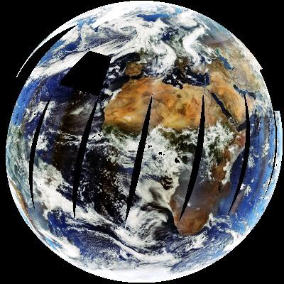
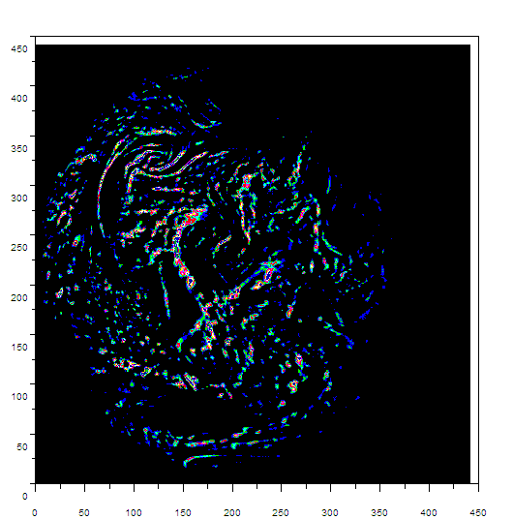
Earth Science Proxy Data
Galileo Jupiter Mission
Earth flyby provided similar view to Lagrange and polar ALO
Deep Space Climate Observatory (DSCOVR)
Solar wind mission
Imager and radiometer will observe poles for extended durations
Higher resolution and more channels
Galileo Near Infrared
Mapping Spectrometer
Aerosols derived from Galileo
Composite of DSCOVR
view from MODIS data
Cloud feature changes
derived from Galileo

Slide 18
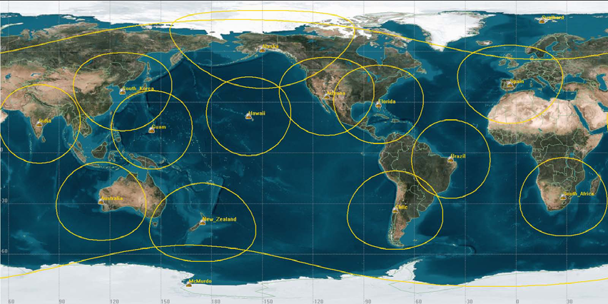
Polar Satellite Communications
30 minute data latency requirement from polar environmental satellites
SafetyNet is a network of 15 ground stations under construction to handle 3 polar environmental satellites generating 15 Mbps data downlinked at 150 Mbps
Includes McMurdo, with GEO crosslink
>6 minute average, 42 minute max latency
Notes:
Bottom line: Large ground network, including expensive Antarctic station with GEO crosslink, that doesn’t provide required 30 minute latency for 100% of its data.

Slide 19
ALO Satellite Crosslink
Two solar sail spacecraft in opposite north/south ALOs
Continuous visibility of one ground station each
~66.5° elevation
30 seconds average, 130 seconds max latency
2 sailcraft & ground stations and near realtime data vs. 15 ground stations
Notes:
Bottom line: Solar sails enable vastly reduced ground infrastructure, with 2 satellites that could serve as platforms for other requirements (SWx, remote sensing, other telecoms), with vastly improved latency.

Slide 20
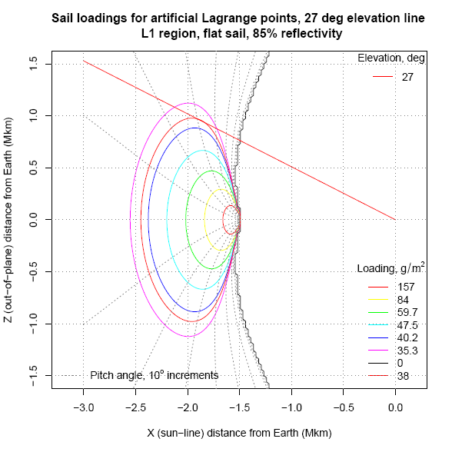
Polar Communications
National Science Foundation (NSF) operates the South Pole research station.
Limited communication coverage (several hours per day) from old geosynchronous satellites in inclined orbits.
A single ALO satellite >22.5° south of L1 or L2 has year-round visibility to the South Pole.
Remaining close to the sun-Earth line also permits solar wind monitoring.
Notes:
Bottom line: Solar sails enable a single satellite to provide continuous data pipe for South Pole scientific research, that can also serve as a sub-L1 solar wind satellite.

Slide 21
Challenges
NOAA depends on NASA for new spacecraft technologies
Current barriers to development
NASA develops technologies for science, not operational requirements
Changing political priorities
Competition between technology programs
Solar sails not flight validated despite compelling applications and progress in ground development
Research to operations transition process is long and arduous
NASA
Researches & develops new technology
Flight validation
Proposes science mission
Flies science mission
NOAA
Evaluates science mission for operational utility
Performs research to operations transition
Flies operational mission

Slide 22
Drivers and Opportunities
National Academy of Sciences
National Space Weather Program
NASA Space Technology Office
Small satellites (nanosatellites, cubesats)
JAXA IKAROS
DSCOVR
Solar wind as operational NOAA capability
Earth science research to operations opportunity
Commercial services

Slide 23
Conclusions
Solar sails enable new orbits
Early solar wind disturbance warnings
Continuous aurora & ionosphere monitoring
Continuous hemispheric polar remote sensing
Greatly reduced infrastructure & latency for polar satellite data downlink
Continuous polar data transmission
New opportunities to overcome historical challenges

